Slide 1
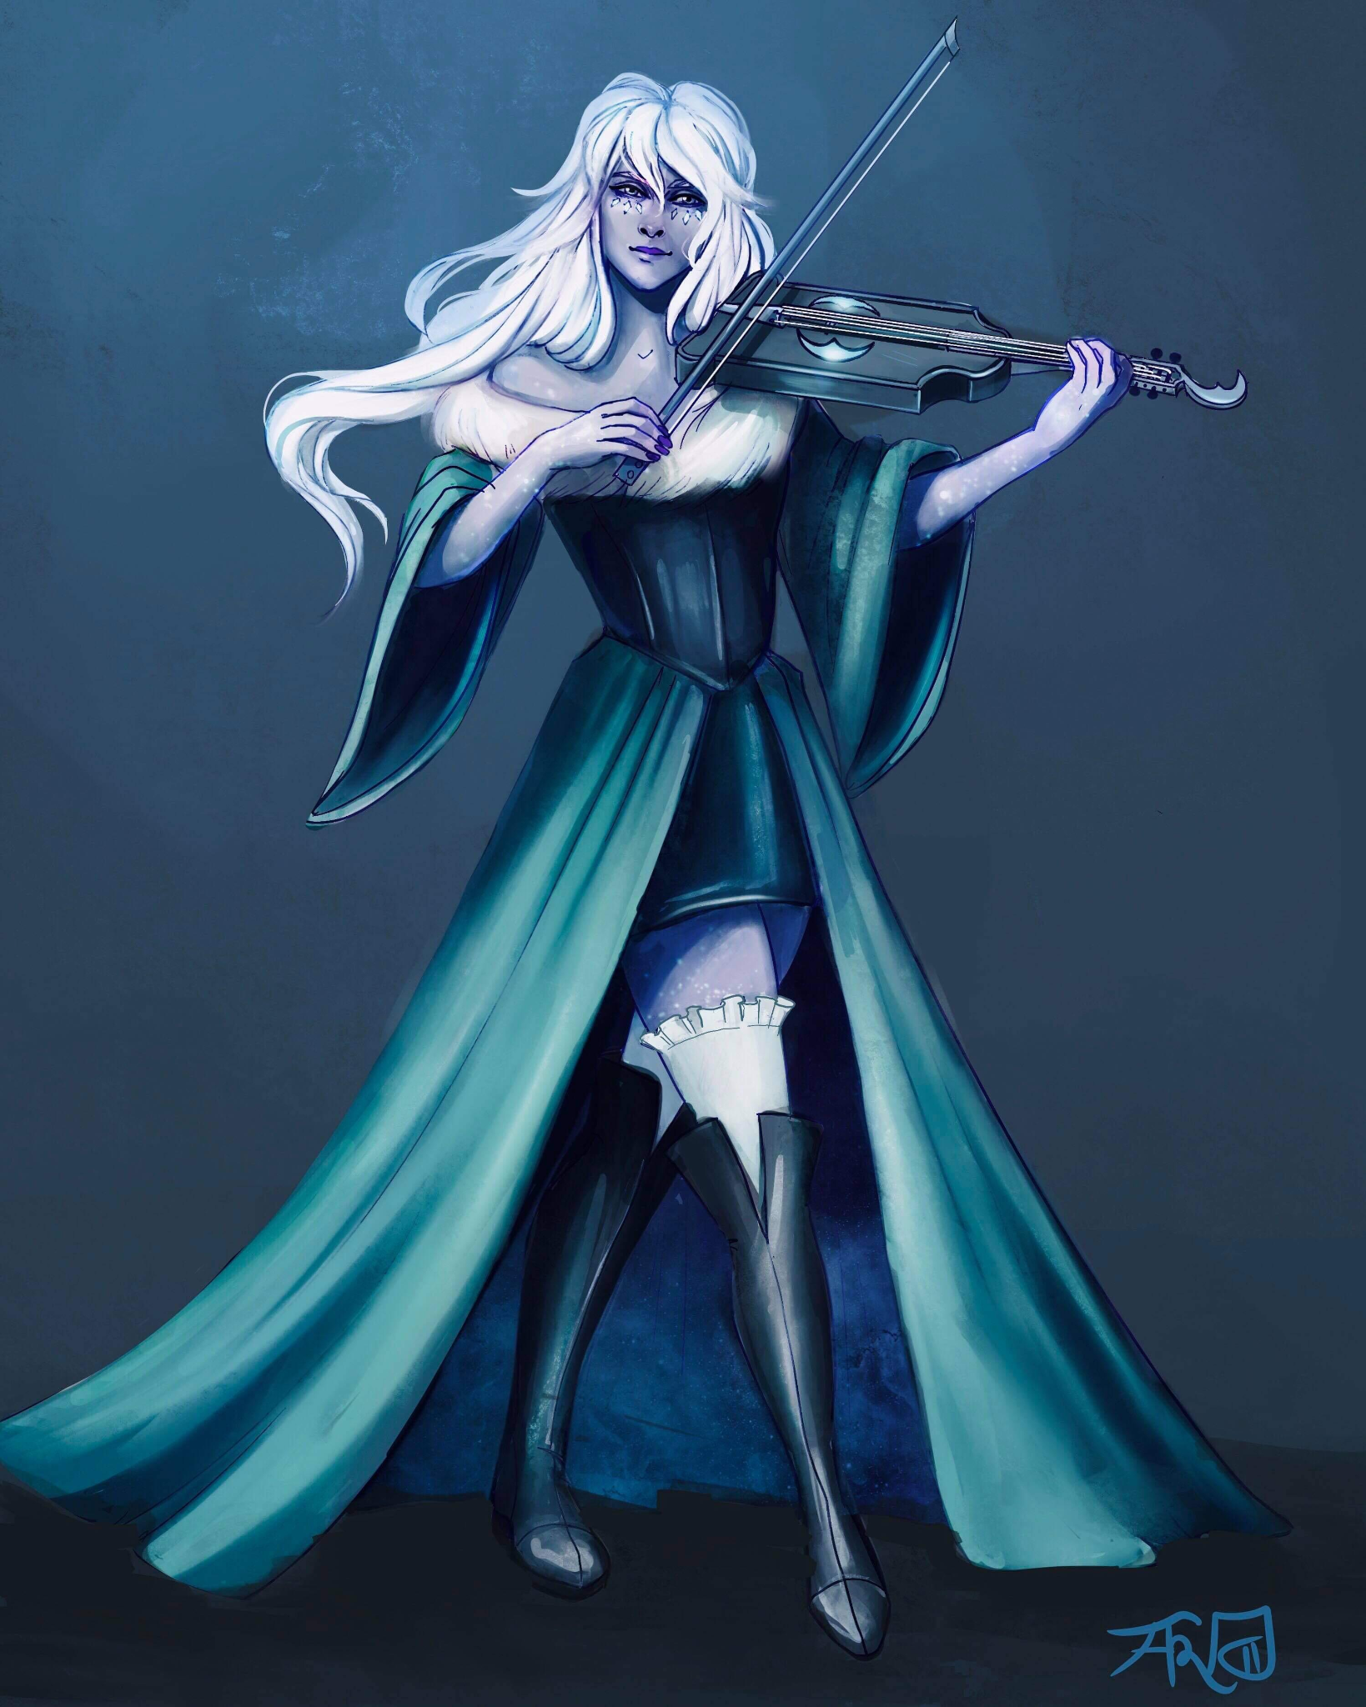
Bethany [Last Name UNKNOWN]
Assistant at the Day Dream Library
Loves to play Viola and wants to prove her worth by joining the Flatcoat Circus.
Currently in a love triangle between Desparia and Hydrangea.

Slide 2
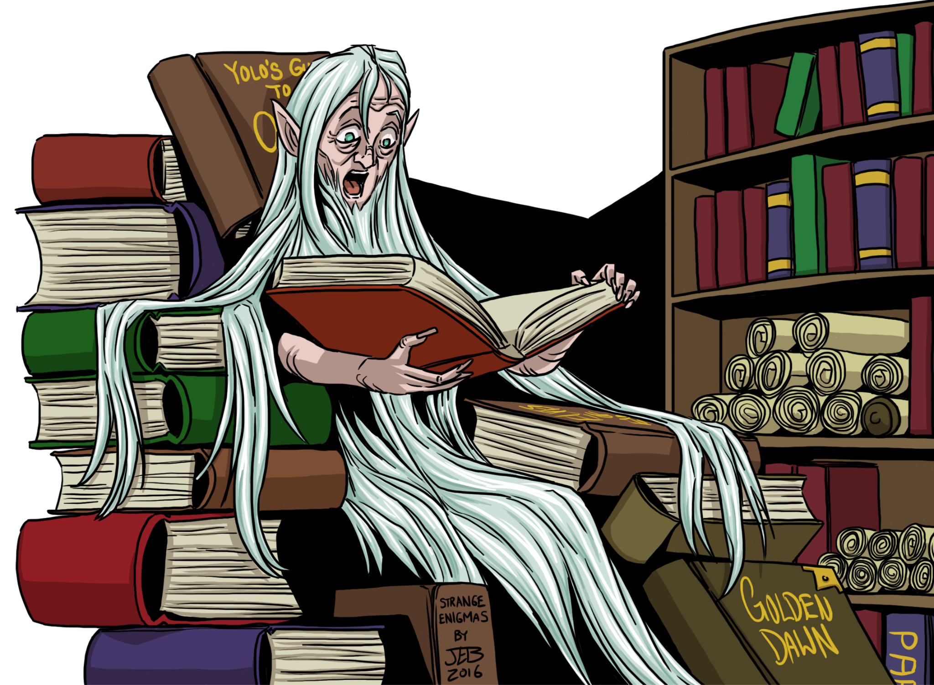
Luanda Hushbringer
Owner of the Day Dream Library

Slide 3
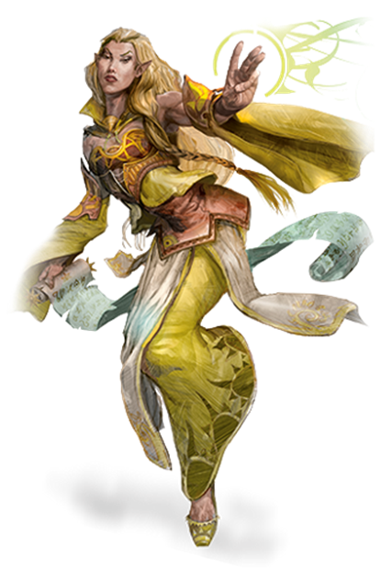
Ramora [Last Name UNKNOWN]
Traveling Adventurer
Works Part-Time at the Day Dream Library
Extremely interested in any ancient artifact

Slide 4
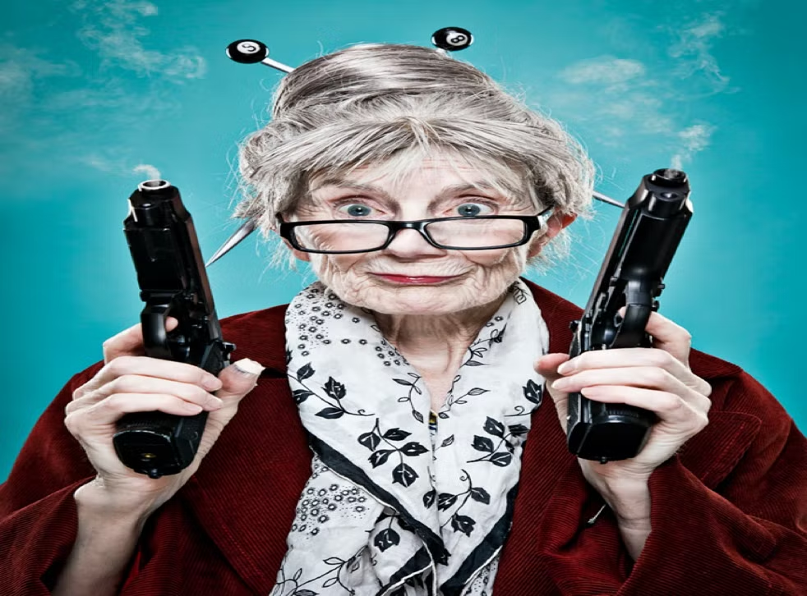
Swan [Last Name UNKNOWN]
Owner of The Thoughtful Baker Bar
Extremely quick when getting drinks and food.

Slide 5
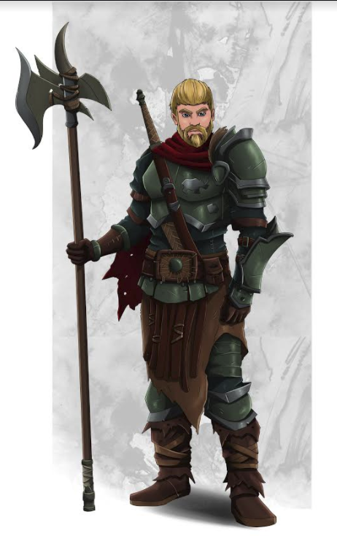
Rhino Varaati
Ex-Arm Wrestling Champion of Helmfield
Depressed due to the current state of his life
Family took in Penguin as a child and raised him as their own

Slide 6
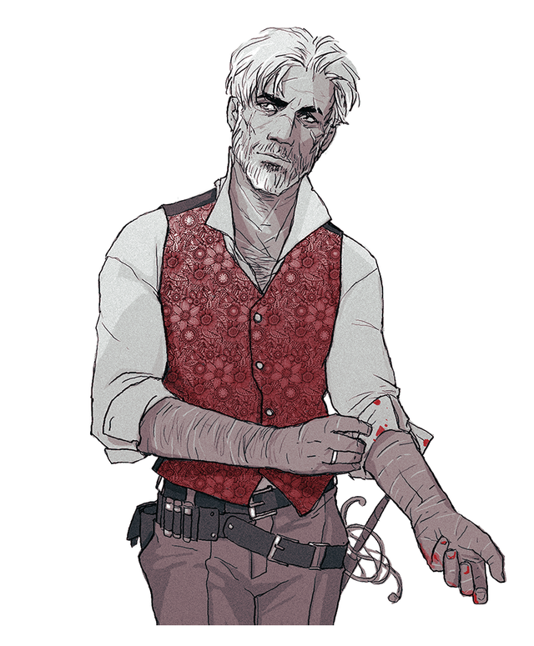
Penguin Varaati/???
Adopted brother of Rhino’s Family
Very protective over Rhino
Warlock gaining power from the left hand to Verrona’s God

Slide 7
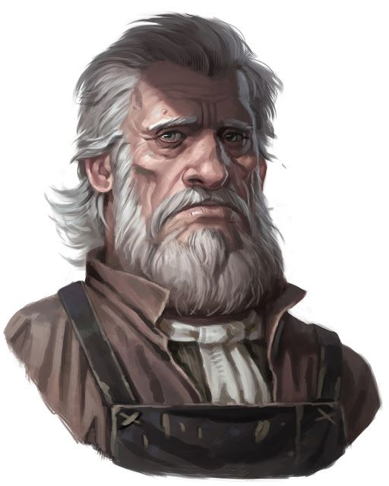
Sunseer Leonhard
Owner of the White Basin Hotel
Upset due to the loss of his lovely wife but wants to try and move on.

Slide 8
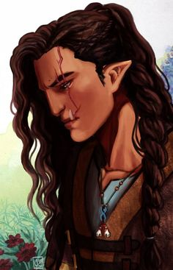
Beverly Caskbow
Owner of the Flowing Hammer
Got her scar from the Helmfield Cave
Joined you in the Helmfield Cave.
Scared to go out on more adventures and is comfortable working as a blacksmith
Level 3 - Barbarian
STR | DEX | CON | INT | WIS | CHA
19 (+4) | 8 (-1) | 19 (+4) | 7 (-2) | 7 (-2) | 10 (+0)

Slide 9
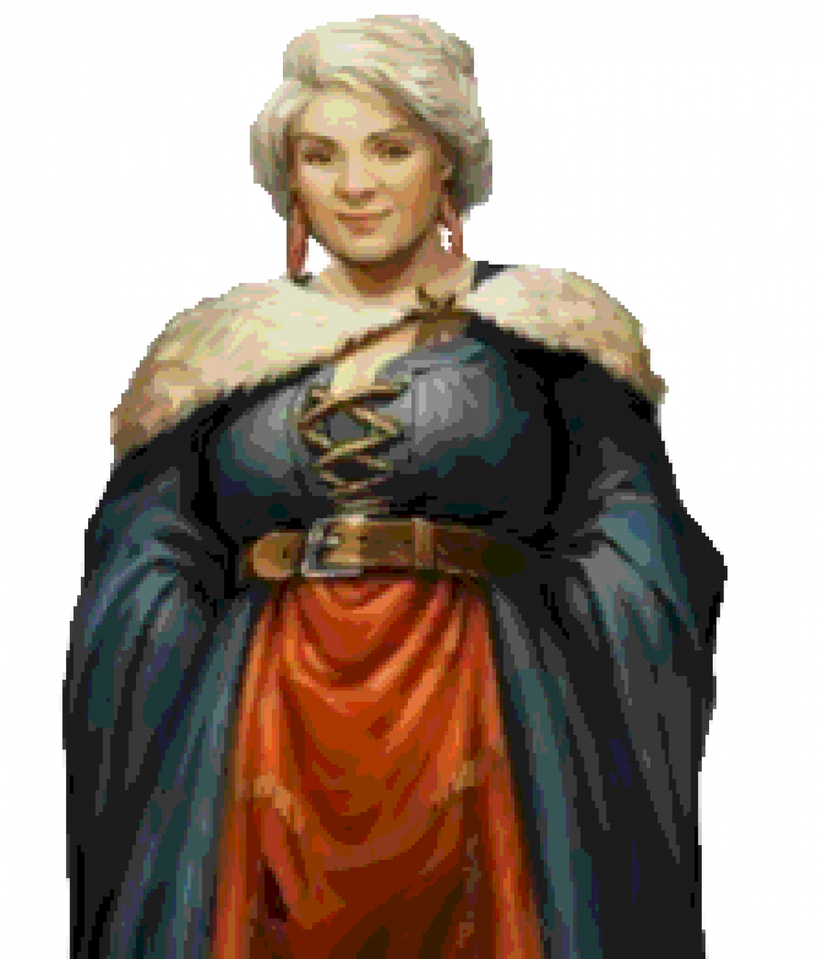
Godiva Commonbrook
Mayor of Helmfield
Her motto: “The people are first, the government is corrupt and make everyone happy!”

